Slide 1
Inspirational Printmakers
Draft version to demo creative process Start with laying out all your slides
Could morph into a different presentation at this point.. Will demo this. It’s like CSS...
This is to show you how to start out with a rough design with no theme...
Notes:
I created my own theme from an existing theme because ....

Slide 2
Overview
Durer
Hokusai
Escher
Elizabeth Catlett
Picasso
Notes:
I chose this because or I created this theme because...

Slide 3
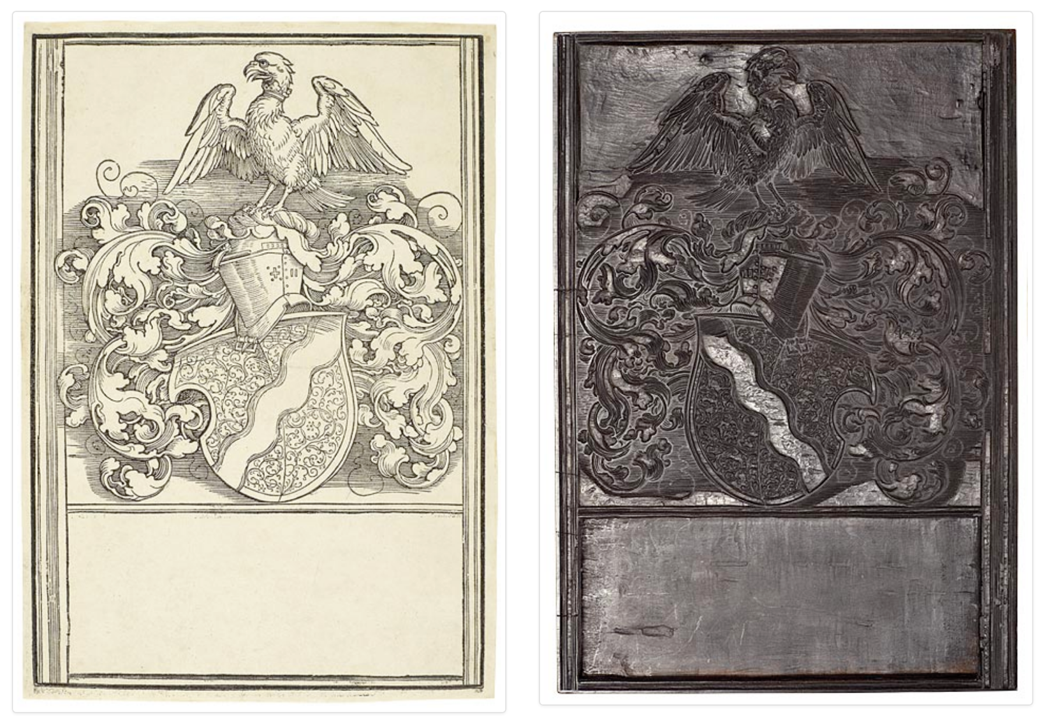
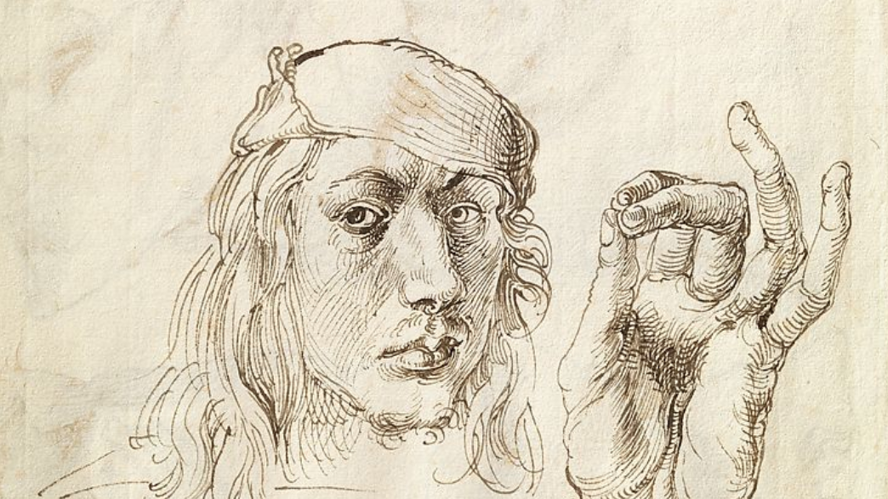
See the process in action
See Dürer at Met

Slide 4
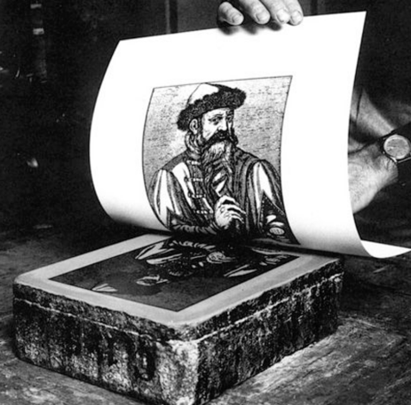
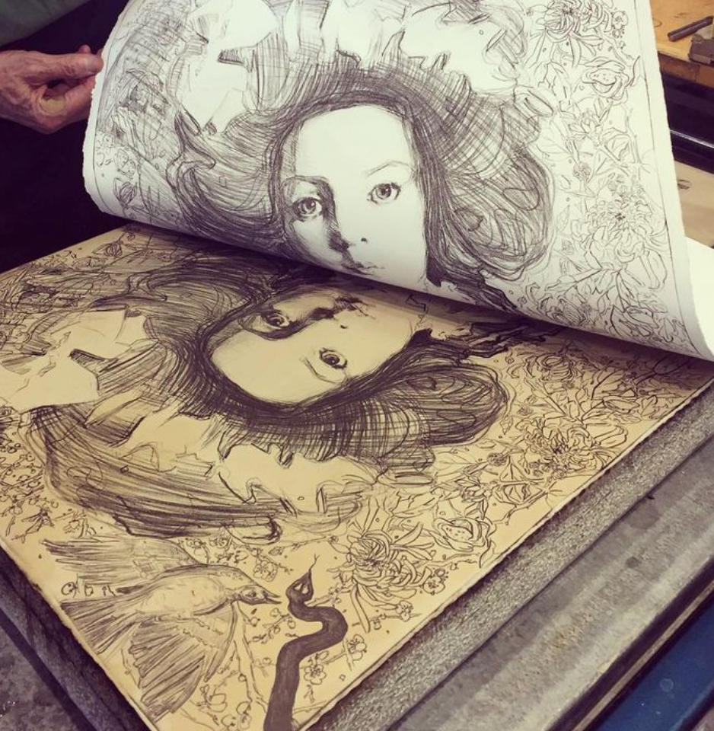
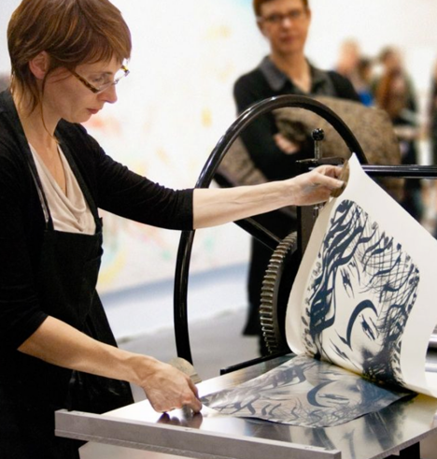

Slide 5
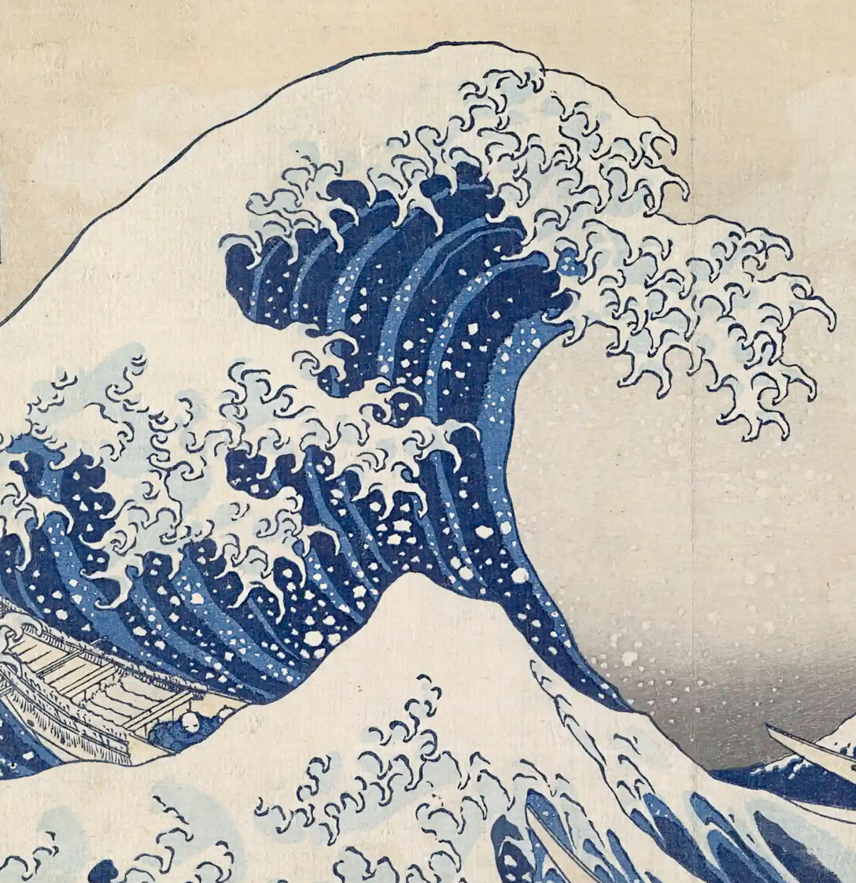
Hokusai

Slide 6
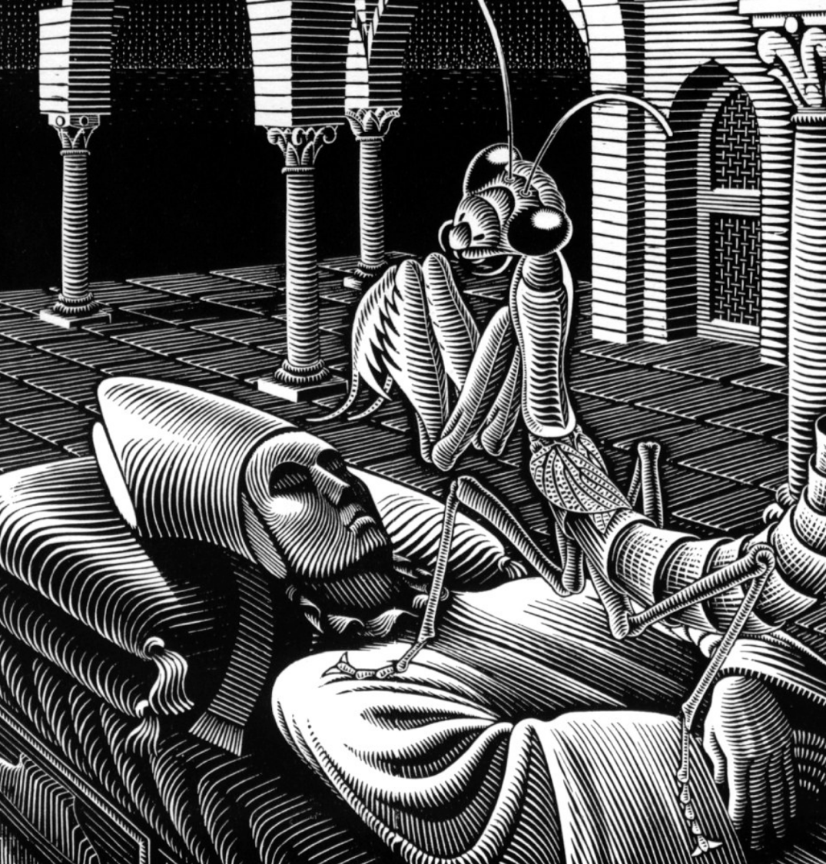

Slide 7
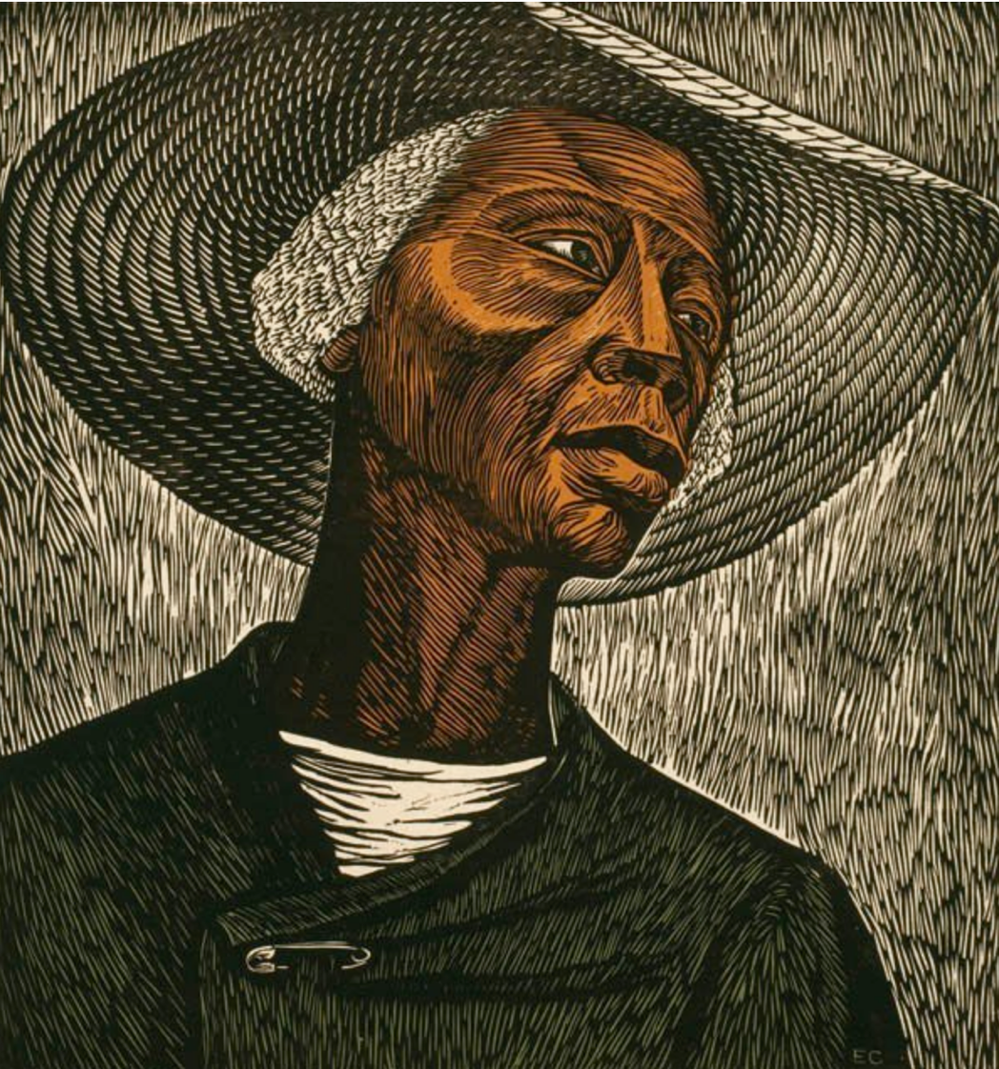

Slide 8
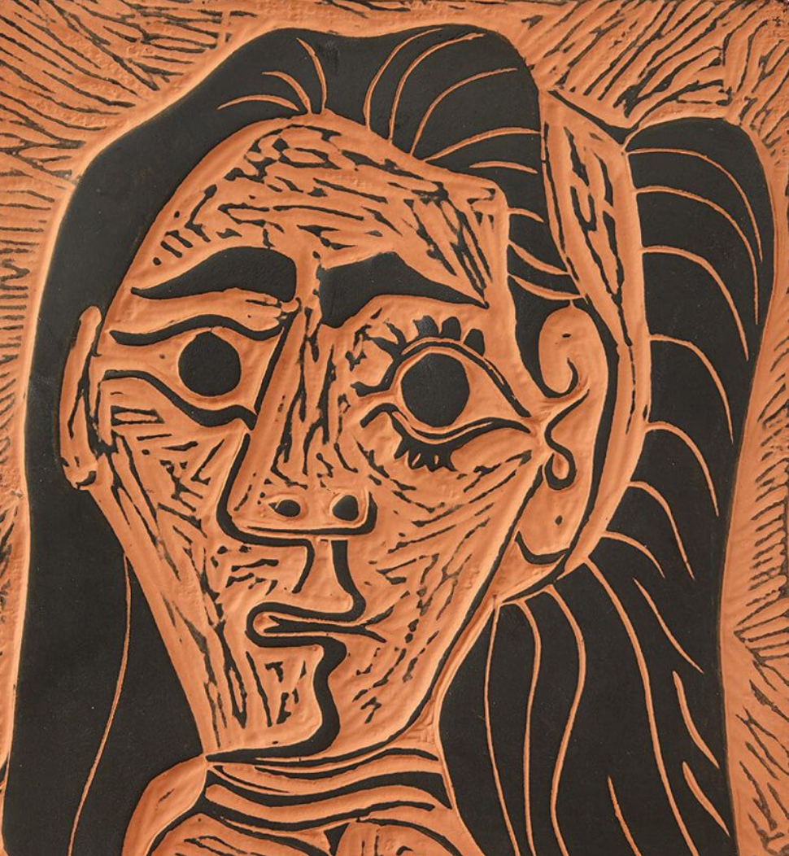

Slide 9
Summary
Durer ......
Hokusai .......
Escher .......
Elizabeth Catlett ......
Picasso ........
Notes:
I chose this because or I created this theme because...

Slide 10
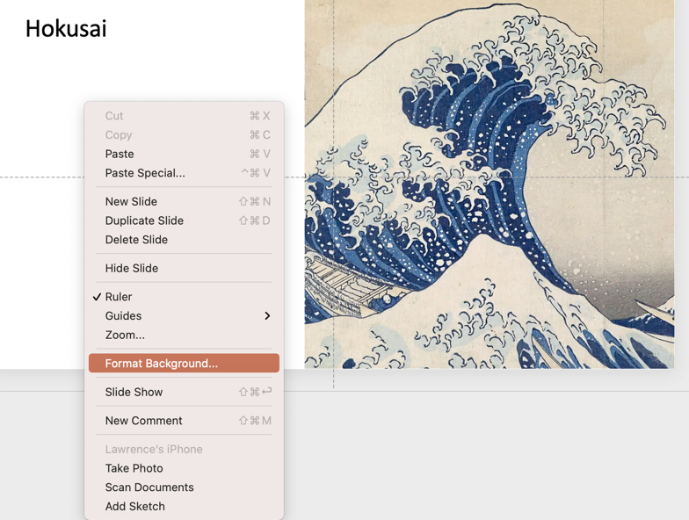
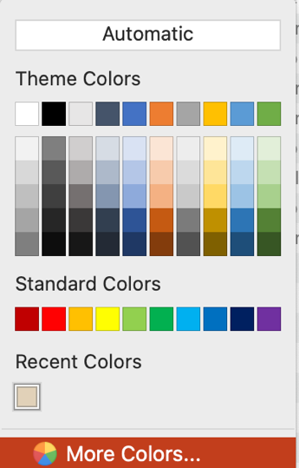
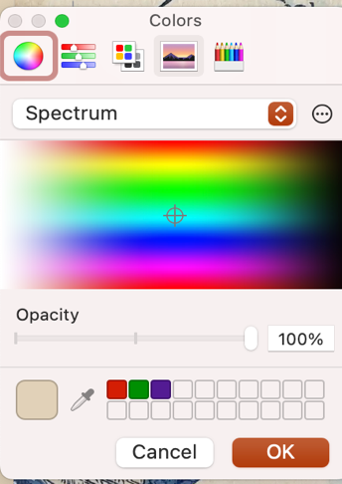
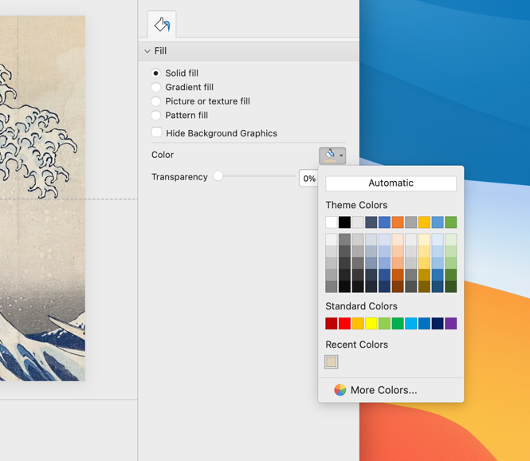
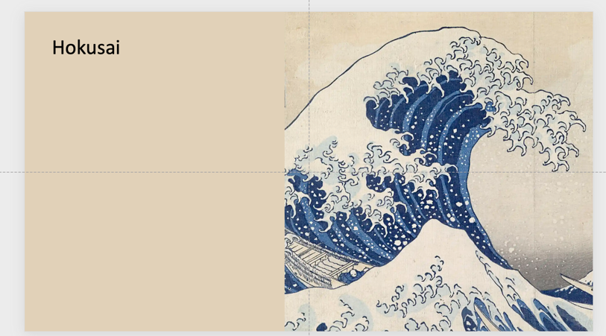
1. Right click background
5. Eye dropper
4. More Colors
2. Format Background
3. Solid fill and Color Bucket
6. Sampled Color

Slide 11
Some links I found looking for images
Meet Vincent: Inspiration from Japan | Van Gogh Museum
Black Women of Print
New Contemporary Chinese Printmakers
Printed copy of the Diamond Sutra
The Diamond Sutra, the Earliest Surviving Dated Complete Printed Book
Category:Printmakers by nationality
As you do more research don’t get pulled down a rabbit trail.... Stick to something you know. This is not a research project. Don’t make this harder than it has to be.

